Slide 1
Milk and Milk Products

Slide 2
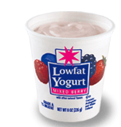

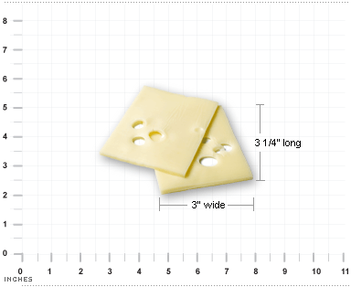
How Much Do I need?
At least 3 cups a day!!

Slide 3
Health Benefits of Milk
Diets rich in milk and milk products help build and maintain bone mass throughout the lifecycle. This may reduce the risk of osteoporosis.
The intake of milk products is especially important to bone health during childhood and adolescence, when bone mass is being built.
Diets that include milk products tend to have a higher overall nutritional quality.

Slide 4
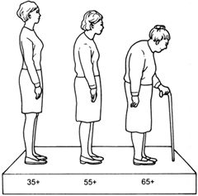
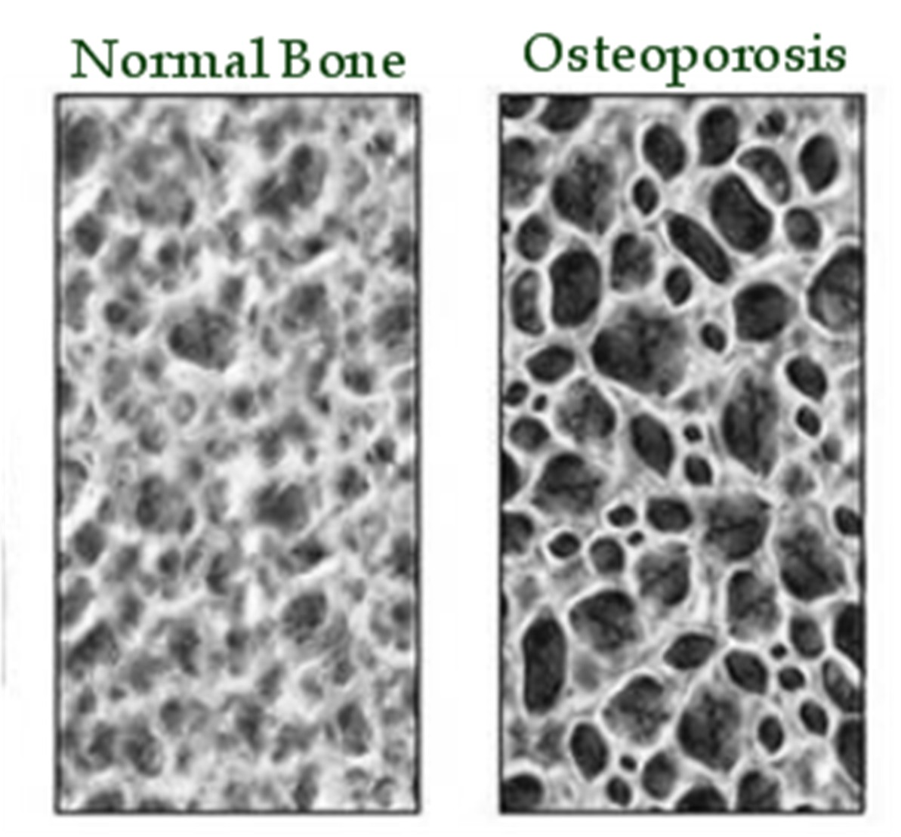
Osteoporosis

Slide 5
Nutrients in Milk
Milk is a good source of nutrients such as:
Protein for growth and repair
Calcium, phosphorus and vitamin D for strong bones and teeth
Vitamin A and Vitamin B for growth and health.

Slide 6

Choosing Low-fat or Fat-free
Include milk as a beverage at meals. Choose fat-free or low-fat milk.
If you drink cappuccinos or lattes—ask for them with fat-free (skim) milk.
Add fat-free or low-fat milk instead of water to oatmeal and hot cereals
Make fruit-yogurt smoothies in the blender.
For dessert, make chocolate or butterscotch pudding with fat-free or low-fat milk.

Slide 7
Types of Dairy Products
Many different types of dairy products are available to consumers. These include:
Milk
Cheese
Frozen milk products
Yogurt
Cream
Butter

Slide 8
Milk
Milk can be bought in many different forms at the grocery store. The main forms are:
  fresh
  UHT processed
  dried
  canned.

Slide 9
Buying Fresh Milk
When buying fresh milk, you may see the following on the label:
GRADE A: this means the milk meets quality standards set by the U.S. Public Health Service
Pasteurized: milk has been heat treated to kill harmful bacteria
Homogenized: means the fat is broken into tiny drops and mixed permanently with the milk. Otherwise, the fat would rise to the top as cream.

Slide 10
Fresh Milk
Fresh milk is commonly used for cooking and drinking.
It varies in fat content
Whole milk contains 3-4% fat
Reduced fat milk contains 2% fat
Low fat milk contains 1% fat
Skim milk contains 0% fat

Slide 11
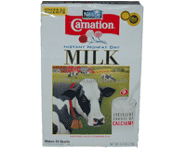
Dry Milk
Dry milk has the water removed so it is in powder form.
It will keep without refrigeration for many months
Once water is added, the milk is similar to fresh milk and must be refrigerated
Used for cooking or drinking, has a slight difference in taste.

Slide 12
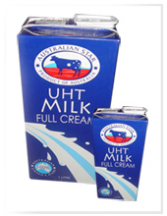
UHT Processed Milk
Milk is sterilized by heating it to a very high temperature for a few seconds to kills all bacteria.
Milk can be stored for up to 3 months without refrigeration.
Once the carton is opened milk must be refrigerated.

Slide 13
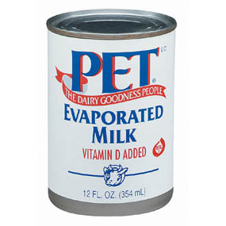
Evaporated Canned Milk
Made from whole milk with 60% of its water removed.
Can add water back for regular milk or is commonly used for cooking.

Slide 14
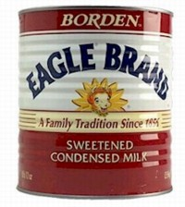
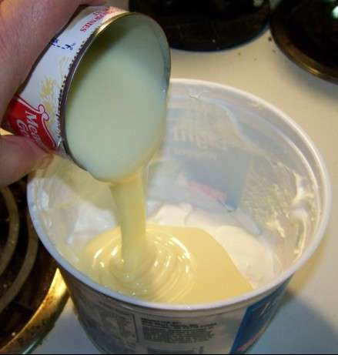
Sweetened Condensed Canned Milk
Has about 60% of is water removed
Sugar is added and cooked to a syrupy consistency.
Used for cooking and baking.

Slide 15
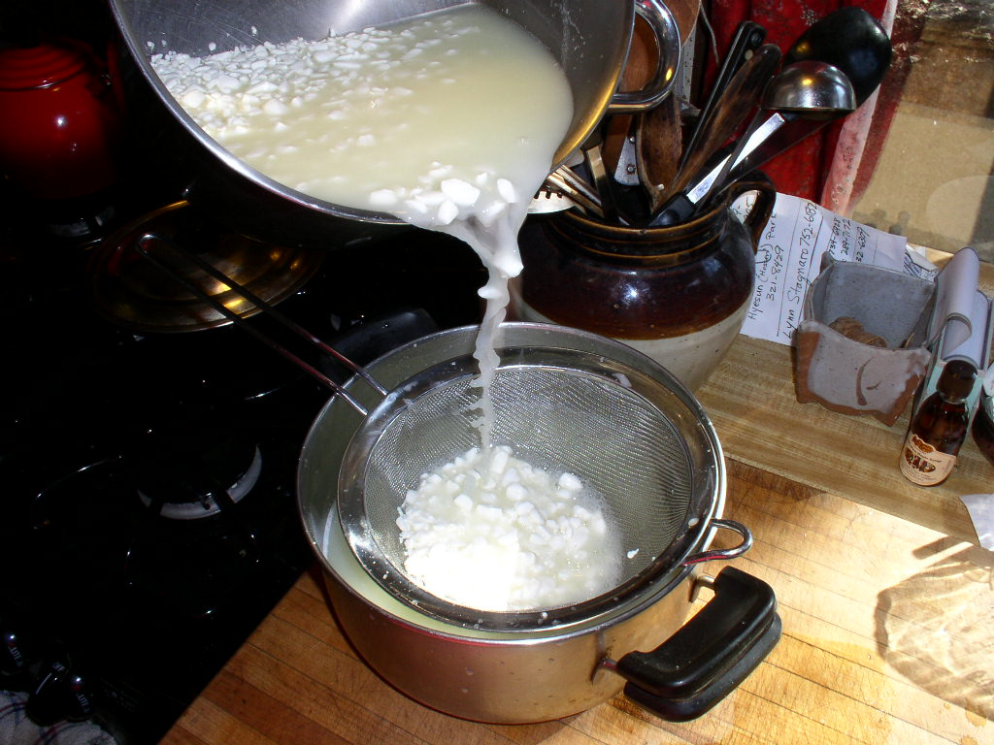
Cheese
Cheese is made from milk by thickening the milk protein
Then the solid portion of the milk (called curds) is separated from the liquid (called whey)
Cheese is made from the solid portion

Slide 16
Natural Cheeses
Unripened
Cheese is ready to eat as soon as whey is removed
They have soft textures and mild flavor
Ex: Cottage cheese and cream cheese
Ripened
Need to be stored to develop flavor and texture.
They have firm textures and stronger flavors
Ex: Swiss, Cheddar, Colby, & Parmesan

Slide 17
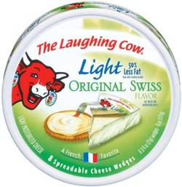
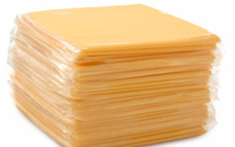

Processed Cheese
Are made by blending natural cheeses through a heating process
Other ingredients or flavors can be added through heating process
Melts easily, has a mild flavor
Ex. American, string cheese, cheese spreads

Slide 18
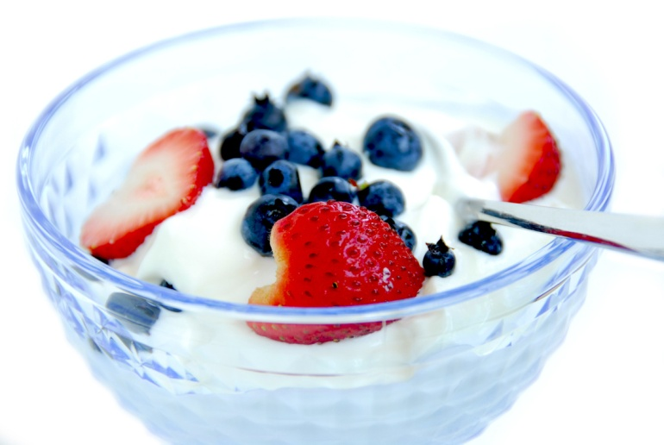
Yogurt
Yogurt is made by adding a special bacteria to milk
The bacteria causes the milk to become thick and creamy with a somewhat sour taste.

Slide 19
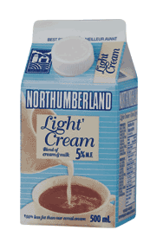
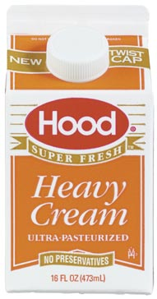
Cream Products
Cream products contain mainly the fat portion of milk.
Heavy whipping cream is used for baking and cooking
Light cream is often used in coffee or in cooking

Slide 20
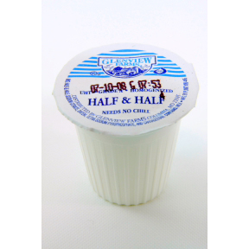
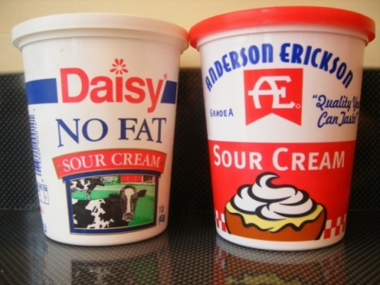
Cream Products
Half-and-half is half cream and half milk. Many people use it in coffee and cooking since it is lower in calories than light cream
Sour cream is made by adding special bacteria to light cream. The bacteria gives the cream a thick texture and sour taste.

Slide 21
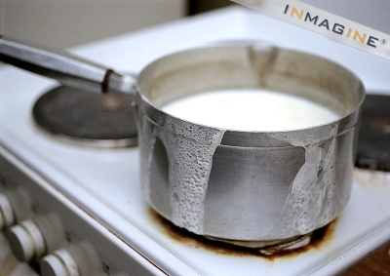
Cooking with Milk
Cook at low temps to prevent milk from burning, which causes a bitter taste
Milk sometimes curdles, or separates into many small lumps. This happens when it is added too quickly to a hot or acidic mixture.

Slide 22
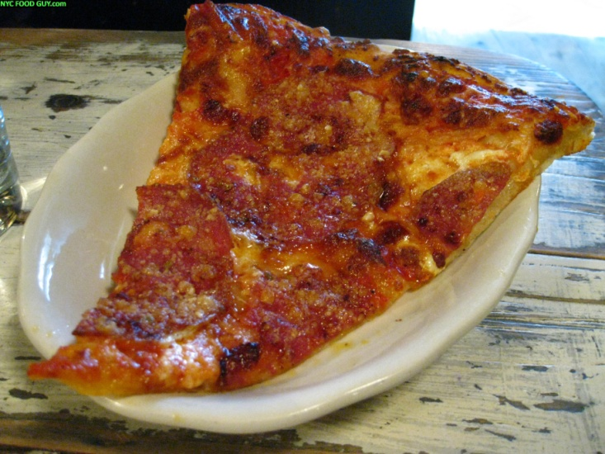
Cooking with Cheese
Cooking cheese too long makes it tough
Cut cheese into smaller pieces so it melts faster
Add cheese the last few minutes of cooking, just until it melts
Cooking cheese at too high a temperature causes it to get rubbery

